Slide 1

Introduction to Data Management Practices course
NBIS DM Team
data@nbis.se
Data Organization practices
https://nbisweden.github.io/module-organising-data-dm-practices/

Slide 2
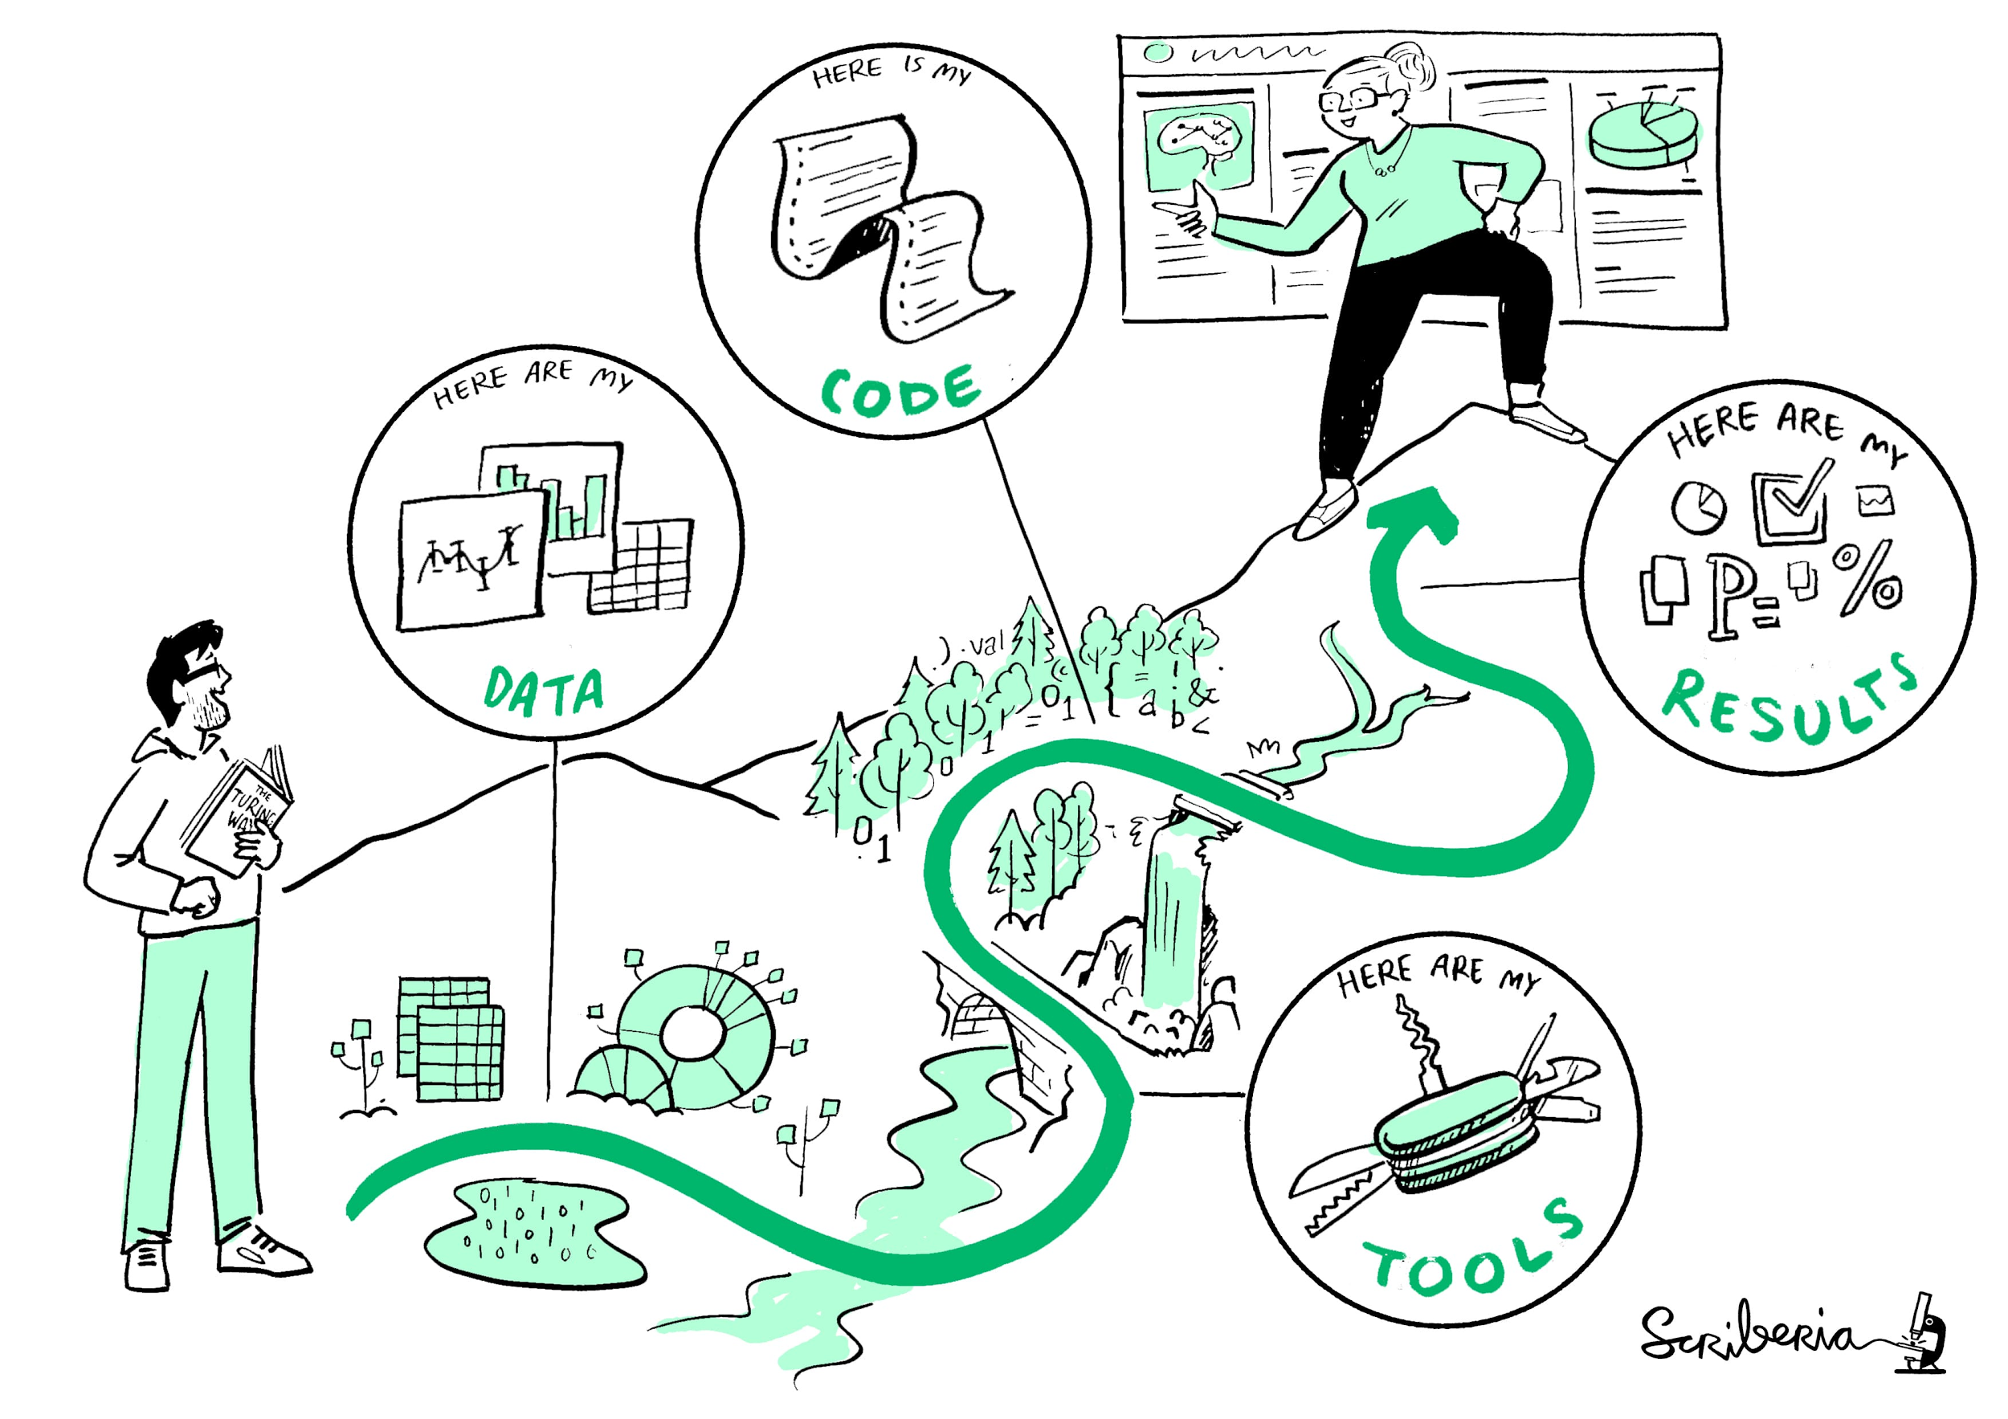
Objectives
What to consider for maintaining data organization strategies in a project
What to consider when settling for a file structure
Understanding good practices for data storage, processing and documentation (FAIR-ification)
Credit: This image was created by Scriberia for The Turing Way community and is used under a CC-BY licence.

Slide 3
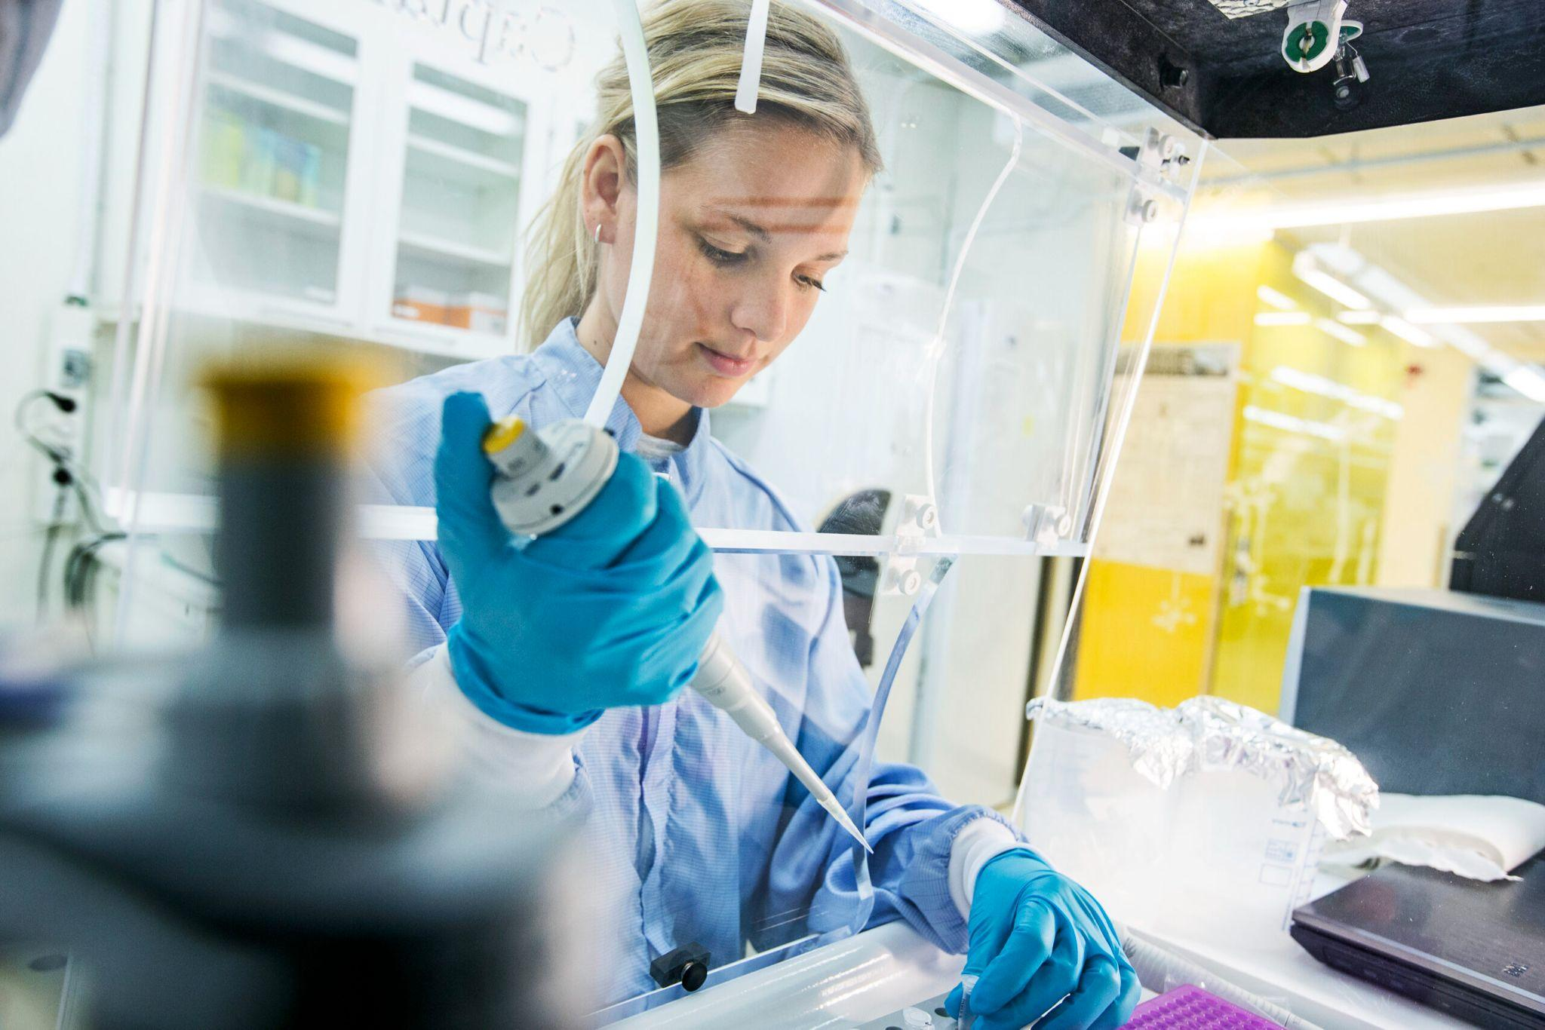
Welcome to Science!
Real Life scenario…
You have been recruited to the “Famous lab”!
Your research project is a continuation of previous work by PhD, Wang Fang (王芳).
You inherit a zipped folder, and a digital copy of the lab notes.
Image: SciLifeLab for Press and Media: https://www.scilifelab.se/contact/for-press-and-media
The road to success is open!

Slide 4
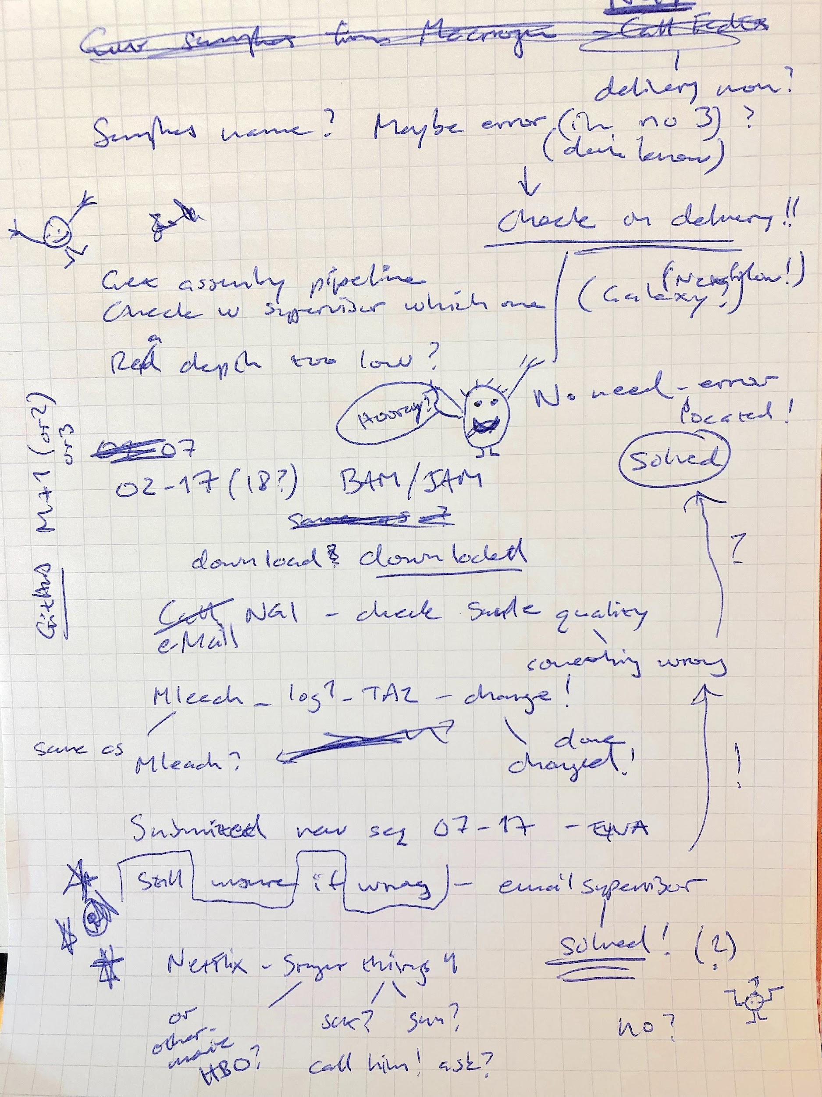
Welcome to Science!
… And this is what you get…
Exercise 1
Can you list at least five major issues with the lab documentation in the image?
Exercise 2
What kind of general questions does the information raise about the work done in the lab?

Slide 5
Importance of good records
Ensures data, analysis and results to be transparent, reproducible and traceable
Prevents future issues due to data mistakes. In cumulative science mistakes can result in cascade effects
Why do we need to keep good quality records?
?
Reduces the risk of data manipulation and
research fraud
Promotes open science and safeguards integrity of science itself

Slide 6
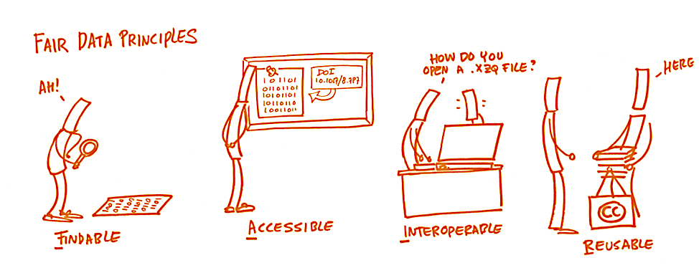
FAIR
Adopting good practices for data organization, makes research data more FAIR
Image: https://book.fosteropenscience.eu/

Slide 7
Data Recipients
People I collaborate with must understand what I do with the data
Colleagues
Scientific community
Society
Yourself
Scientists wanting to reuse or review my data can find and understand the data
The society funding my research have a right to know what happens to the data
“Your future You” will not always remember what “Your present You” decided today

Slide 8
Principles for good records
Contents in protocols can include
Name, affiliation and contact information
Originator of protocol (if not you)
Information on why and how experiment was done
Health and safety advice (and technical advice)
Required software, materials and instruments
Being self-explanatory
Describe mistakes (for others to avoid repeating)
Reference ethical application (if applicable)
Protocols and lab notes should both be…
Detailed
Up-to-date
Accurate
Easy to understand
Contents in lab notes can include
Name and affiliation
Details on what, when and how
What project the experiment is part of
Lot and batch numbers for consumables
Information on metadata* collected
Interpretation of outcome and outlook/plans
Post-outcome treatment of data
*The information needed to discover, use, and understand data

Slide 9
Exercise 3
Test yourself on record keeping statements
Analogues and digital records make information equally findable.
New information in digital records can be easily shared with other users.
Analogue records can be kept safe from any physical accidents.
All researchers in a shared lab should have access to the same platform for keeping records and taking notes.
Digital records should follow the same backup strategy as the data they describe.

Slide 10
Exercise 3
Test yourself on record keeping statements
Analogue and digital records makes information equally findable. (F)
New information in digital records can be easily shared with other users. (T)
Analogue records can be kept safe from any physical accidents. (F)
All researchers in a shared lab should have access to the same platform for keeping records and taking notes. (T)
Digital records should follow the same backup strategy as the data they describe. (T)

Slide 11
FAIR by README
A README file usually defined as the starting point of information about something
FAIRify your research by using README files as documentation files for:
Folder level Explaining folder contents, naming, file history, organisation/structure etc
Data Explaining file names and contents
README in Markdown (.md)
Allows text and content formatting without interference
Highly compatible with e.g. GitHub
Allows inclusion of comments without having to visualize them
Easily editable and versatile
Does not require particular skills

Slide 12
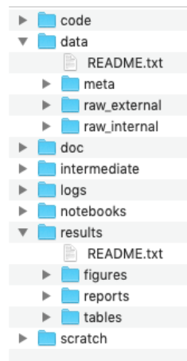
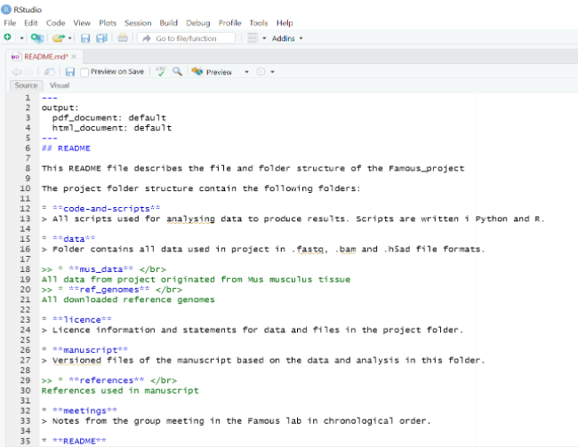
README
README in Folder
README in Markdown.md

Slide 13
Exercise 4
Discussion
Consider an example where you would have benefited from having access to a README file when working with data.
Describe to your neighbor what you would have wanted such a file to contain.

Slide 14
Backup
Data and hardware failure is always a threat.
Plan early (have a backup strategy) for potential failure!
Good to know for backup planning purposes:
Data sensitivity
Ease of access
File sizes
Overall data volumes
Data life cycle in project

Slide 15
Backup
Nearly all data, metadata and project information necessary to understand your analysis and results require some sort of backup strategy
Try to keep backup in three separate copies, on at least two different kinds of media (server, portable hard drive, cloud). Consider off-site backups
Never backup your data on portable drives only, and particularly not on USB sticks!
Robust backups need to be automated

Slide 16
Exercise 5
Discussion
Discuss in pairs the validity of the following statements on data backup:
I have my most important data backed up on my laptop. I have never experienced a hard drive failure, and my current laptop has a new state-of-the-art hard drive. Therefore, I don't need external backups.
All my data is stored in a cloud service.
My data is on a portable hard drive. There is a backup of the most important files on a shared USB stick in my research group.
My data is on a departmental backup administered by my University. Additionally, we have a server for all the data stored in our project.
We have no shared backup at all. All members in our research group are responsible for their own data.

Slide 17
Exercise 5
Discussion
Discuss in pairs the validity of the following statements on data backup:
Unsafe and not recommended. All hard drives can be subject to failure. In case of failure, all data will be lost.
Cloud services can be sufficient as backup, but are not fail safe. It can be sufficient in combination with a secondary backup on e.g. a shared server. For certain types of data (e.g. sensitive information), a cloud service may be outright inappropriate.
Not a good solution. Both portable hard drives as well as USB sticks are prone to failure.
A good solution in general. Data is stored independently in two separate systems. Centrally administered services are usually organised in such a way that partial failures does not affect the users.
Worst possible alternative. A disaster waiting to happen!

Slide 18
Backup
Creating a backup strategy in 10 steps
Find out whether your institution has a backup strategy
Determine what you want to back up
Decide how many backups you will need and how frequently to backup
Decide where backups will be stored
Determine how much storage capacity will be needed
Determine if there are tools you could use to automate backup
Determine how long backups will be kept and how they will be destroyed
Determine how personal data will be protected
Devise a disaster recovery plan
Assign responsibilities

Slide 19
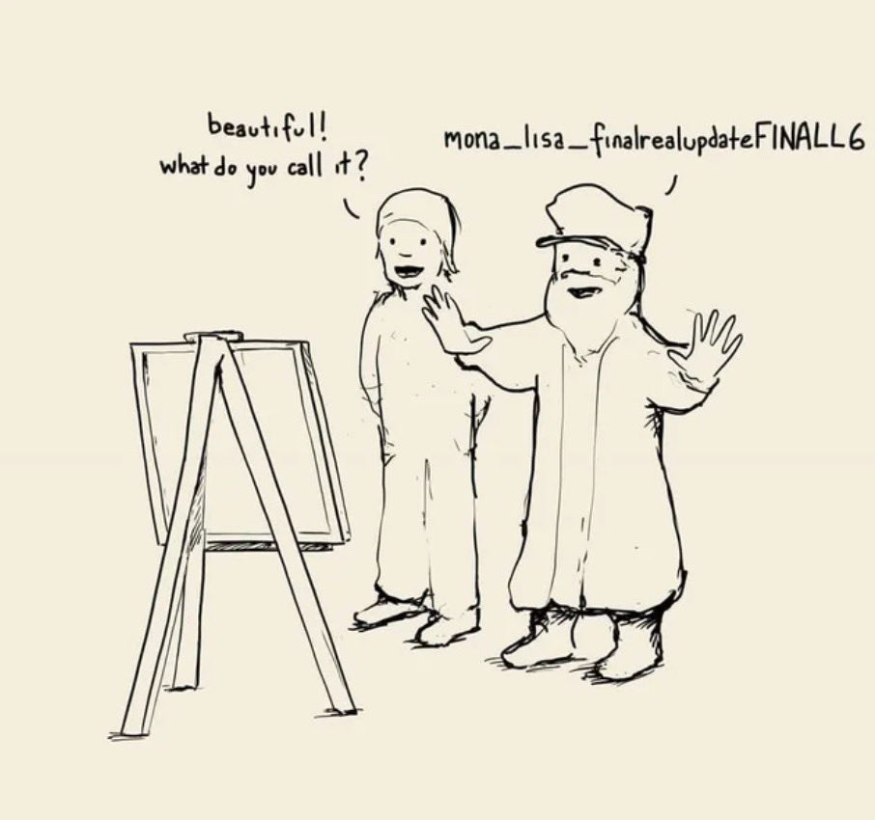
Files and Folders
Why is file organisation important for data management?
What level of data organisation will work for me and my project/ team?
https://twitter.com/nathanwpyle/status/1108902487203958784

Slide 20
File organisation
Benefits of systematically organising research and data files in your project :
Easier to locate a file
Find similar files together
Easy to identify which files you want to back up
Moving files becomes much easier
Increases productivity
Helps you to keep and maintain a record of the project
Projects can easily be understood by others (including your future self)
Keep organised in the long-run

Slide 21
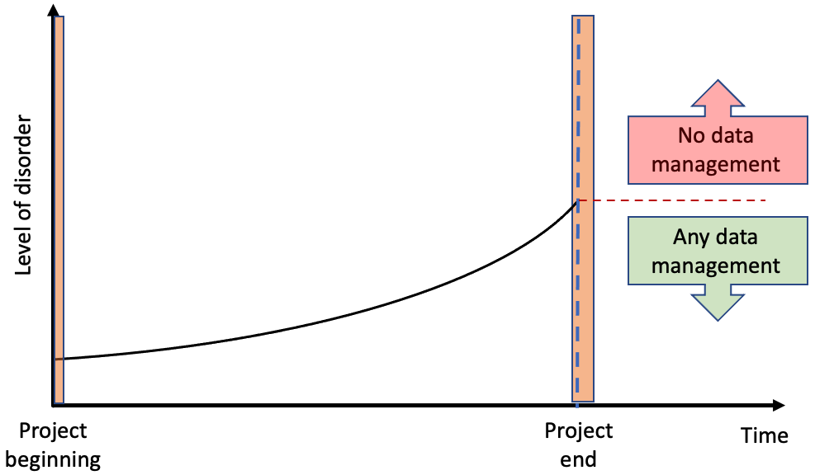
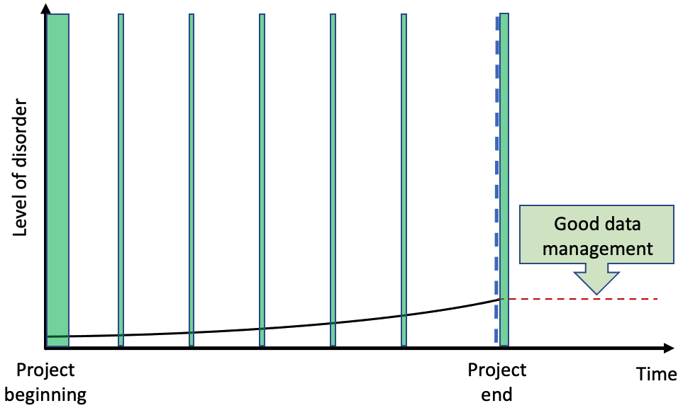
File organisation
Files will become unorganised over time (particularly downloads and/or desktop folders)
Files can multiply across folders and versions, decreasing findability
Organising will reduce clutter and maintenance requirements over time

Slide 22
File and Folder naming
Names for files and folders should be consistent and meaningful to yourself and collaborators
Example:
LD_phyA_off_t04_2020-08-12_norm.xlsx
Based on the name, the file could contain information about:
LD | Long day sampling, of the
phyA | Phytochrome A genotype, in a
off | Medium without sucrose, at
t04 | Time point 4
2020-08-12 | Sampled on Aug 12th, 2020, with
norm | Normalised data

Slide 23
File and Folder naming
Names for files and folders should be consistent and meaningful to yourself and collaborators
Example:
LD_phyA_off_t04_2020-08-12_norm.xlsx
Based on the name, the file could contain information about:
LD | Long day sampling, of the
phyA | Phytochrome A genotype, in a
off | Medium without sucrose, at
t04 | Time point 4
2020-08-12 | Sampled on Aug 12th, 2020, with
norm | Normalised data
Not obvious from the letters and words alone. Explanation is required -
README.md

Slide 24
Exercise 6
Group discussion
The following example contain files from an imaginary project
2020-07-14_s12_phyB_on_SD_t04.raw.xlsx
2020-07-14_s1_phyA_on_LD_t05.raw.xlsx
2020-07-14_s2_phyB_on_SD_t11.raw.xlsx
2020-08-12_s03_phyA_on_LD_t03.raw.xlsx
2020-08-12_s12_phyB_on_LD_t01.raw.xlsx
2020-08-13_s01_phyB_on_SD_t02.raw.xlsx
2020-7-12_s2_phyB_on_SD_t01.raw.xlsx
AUG-13_phyB_on_LD_s1_t11.raw.xlsx
JUL-31_phyB_on_LD_s1_t03.raw.xlsx
LD_phyA_off_t04_2020-08-12.norm.xlsx
LD_phyA_on_t04_2020-07-14.norm.xlsx
LD_phyB_off_t04_2020-08-12.norm.xlsx
LD_phyB_on_t04_2020-07-14.norm.xlsx
SD_phyB_off_t04_2020-08-13.norm.xlsx
SD_phyB_on_t04_2020-07-12.norm.xlsx
SD_phya_off_t04_2020-08-13.norm.xlsx
SD_phya_ons_t04_2020-07-12.norm.xlsx
ld_phyA_ons_t04_2020-08-12.norm.xlsx
phyA/phyB - genotypes
sXX - sample number
LD/SD - light conditions (Long Day, Short Day)
on/off - different growth media (on sucrose, off sucrose)
date format - sample date
tXX - sample time point
raw, norm - raw or normalised data

Slide 25
Exercise 6
Should dates be put first, and if not, why?
What is the difference between using leading 0 (zero) and not?
Is there a difference between using upper and lower case letters?
What is the difference between using two letters for on compared to three letters ons?
What are the effects if we, as in the above example, mix naming conventions?
2020-07-14_s12_phyB_on_SD_t04.raw.xlsx
2020-07-14_s1_phyA_on_LD_t05.raw.xlsx
2020-07-14_s2_phyB_on_SD_t11.raw.xlsx
2020-08-12_s03_phyA_on_LD_t03.raw.xlsx
2020-08-12_s12_phyB_on_LD_t01.raw.xlsx
2020-08-13_s01_phyB_on_SD_t02.raw.xlsx
2020-7-12_s2_phyB_on_SD_t01.raw.xlsx
AUG-13_phyB_on_LD_s1_t11.raw.xlsx
JUL-31_phyB_on_LD_s1_t03.raw.xlsx
LD_phyA_off_t04_2020-08-12.norm.xlsx
LD_phyA_on_t04_2020-07-14.norm.xlsx
LD_phyB_off_t04_2020-08-12.norm.xlsx
LD_phyB_on_t04_2020-07-14.norm.xlsx
SD_phyB_off_t04_2020-08-13.norm.xlsx
SD_phyB_on_t04_2020-07-12.norm.xlsx
SD_phya_off_t04_2020-08-13.norm.xlsx
SD_phya_ons_t04_2020-07-12.norm.xlsx
ld_phyA_ons_t04_2020-08-12.norm.xlsx
phyA/phyB - genotypes
sXX - sample number
LD/SD - light conditions (Long Day, Short Day)
on/off - different growth media (on sucrose, off sucrose)
date format - sample date
tXX - sample timepoint
raw, norm - raw or normalised data

Slide 26
Exercise 6
Should dates be put first, and if not, why?
What is the difference between using leading 0 (zero) and not?
Is there a difference between using upper and lower case letters?
What is the difference between using two letters for on compared to three letters ons?
What are the effects if we, as in the above example, mix naming conventions?
2020-07-14_s12_phyB_on_SD_t04.raw.xlsx
2020-07-14_s1_phyA_on_LD_t05.raw.xlsx
2020-07-14_s2_phyB_on_SD_t11.raw.xlsx
2020-08-12_s03_phyA_on_LD_t03.raw.xlsx
2020-08-12_s12_phyB_on_LD_t01.raw.xlsx
2020-08-13_s01_phyB_on_SD_t02.raw.xlsx
2020-7-12_s2_phyB_on_SD_t01.raw.xlsx
AUG-13_phyB_on_LD_s1_t11.raw.xlsx
JUL-31_phyB_on_LD_s1_t03.raw.xlsx
LD_phyA_off_t04_2020-08-12.norm.xlsx
LD_phyA_on_t04_2020-07-14.norm.xlsx
LD_phyB_off_t04_2020-08-12.norm.xlsx
LD_phyB_on_t04_2020-07-14.norm.xlsx
SD_phyB_off_t04_2020-08-13.norm.xlsx
SD_phyB_on_t04_2020-07-12.norm.xlsx
SD_phya_off_t04_2020-08-13.norm.xlsx
SD_phya_ons_t04_2020-07-12.norm.xlsx
ld_phyA_ons_t04_2020-08-12.norm.xlsx
1.Using dates as leading information in file names makes finding data quickly harder as the more interesting information may be samples or timepoints (unless date is crucial to data)
2. Without leading zeros, sorting will make 10 and 11 appear before 2
3. Upper and lower cases may sort differently
4. Comparing files is easier if the file name lengths are uniform
5. Mixed naming conventions can make it difficult to locate particular files, and/or sort a large number of files

Slide 27
File naming Do’s
For dates use the YYYY-MM-DD standard and place at the end of the file UNLESS you need to organize your files chronologically
Include version number (if applicable), use leading zeros (i.e.: v005 instead of v5)
Add a README.md (PROJECT_STRUCTURE.md) file in your top directory which details your naming convention, directory structure and abbreviations
Make sure the end-letter file format extension is present at the end of the name (e.g. .doc, .xls, .mov, .tif)

Slide 28
File naming Dont’s
Using spaces (use _ or - )
Long names
Repetition, e.g if directory name is Electron_Microscopy_Images, file ELN_MI_IMG1_S01_20200101.img then ELN_MI is redundant
(applicable if the file is not going to be accessed independently of the location)
Dots, commas and special characters (e.g. ~ ! @ # $ % ^ & * ( ) ` ; < > ? , [ ] { } ‘ “)
Using language specific characters (e.g óężé)
Deep paths with long names (i.e. deeply nested folders with long names), as archiving or moving between OS may fail

Slide 29
File naming strategy
Two starting points for your file naming are:
A file name is a principal identifier of a file
useful clues to the content
status and version of a file
help in classifying and sorting files
facilitate searching and discovering files
File naming strategy should be consistent in time and among different people
systematic and consistent across all files in the study
a group of cooperating researchers should follow the same file naming strategy
file names should be independent of the location of the file on a computer

Slide 30
Exercise 7
Group discussion
What are the potential benefits of agreeing on a File Naming Convention for a project?
Some benefits can be …
Easier to process - Users will not have to over think the file naming process
Easier to facilitate access, retrieval and storage of files
Easier to browse through files, saving time and effort
Harder to lose!
Having logical and known naming conventions in place can also help you with version control.
Check for obsolete or duplicate records

Slide 31
Principles for naming files
How to organise files and folders?
Consider file name lengths
Beware of operative systems limitations and full path names!
Make names human readable
Name describes content of file
Make names machine readable
Avoid spaces, punctuations, accented characters
Explain file naming in associated info files (README.md)

Slide 32
File naming
Examples of a poor file name:
”Honeybee project, experiment 2 done in Helsinki, data file created on the second of December 2020”
File name - Runnew_again_2NDTRY.xls
Explanation - N/A

Slide 33
File naming
Examples of a good file name:
”Honeybee project, experiment 2 done in Helsinki, data file created on the second of December 2020”
File name - 20201202_HB_EXP2_HEL_DATA_V03.xls
Explanation - Date_ProjectAbbreviation_ExperimentNumber_
Location_TypeOfData_VersionNumber

Slide 34
File naming convention
Want to create your own File Naming Convention? Consider…
What group of files will this naming convention cover?
What information (metadata) is important about these files and makes each file distinct?
Do you need to abbreviate any of the metadata or encode it?
What is the order for the metadata in the file name?
What characters will you use to separate each piece of metadata in the file name?
Will you need to track different versions of each file?
Write down your naming convention pattern
Document this convention in a README.md and keep it with your files
Briney, Kristin A. (2020) File Naming Convention Worksheet. [Teaching Resource]

Slide 35
File versioning
The simple yet powerful Dont’s and Do’s of file versioning:
Dont’s
Add suffixes like FINAL, THIS_ONE, or PUB, to file names
Add numbers to already bad suffixes (e.g. FINAL_2, PUB_5, etc)
Add negative information (e.g. DELETE_THIS, or DO_NOT_KEEP)
Do’s
Explicitly include versioning in file naming convention
Use version numbers, preferably consistently

Slide 36
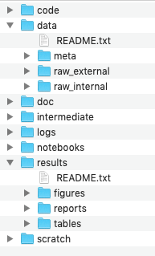
Directory structure for a sample project
all code needed to go from input files to final results
raw and primary data, essentially all input files, never edit!
documentation for the study
output files from different analysis steps, can be deleted
logs from the different analysis steps
output from workflows and analyses
temporary files that can be safely deleted or lost
Noble WS (2009) A Quick Guide to Organizing Computational Biology Projects. PLoS Comput Biol 5(7): e1000424.
http://journals.plos.org/ploscompbiol/article?id=info:doi/10.1371/journal.pcbi.1000424

Slide 37
Exercise 10
We are back in the Famous lab!
Considering the very limited metadata we have access to, and the inherited files, what can we do in order to increase the level and quality of data organization?
Download the zip-file containing the inherited data structure
Consider the following:
- File names
- Folder structure
- Documentation
Work in pairs or in smaller groups.
Focus on the discussion more than finishing the exercise.
Consider your own data and files from a third-person-view

Slide 38
Tabular data
Tabular data (or spreadsheet data) refers to data that is organized in a table with rows and columns
Tabular data is not a data type, but …
- a way to organize data
- designed for machine readability
Long term storage, exporting, archiving and FAIRification by converting to .CSV or .TSV

Slide 39
Tabular data
Good practice for structuring tabular data is to…
Think about how to organize your data both from a data entry and data analysis point of view from the beginning
Adopt good metadata standards and column header formats early in the data collection phase
Setting up well-formatted tables early in the research process is extremely important – before you even start entering data
Separate raw data from the analysed data can have different layout/format
Leave the original (raw) data raw!!!

Slide 40
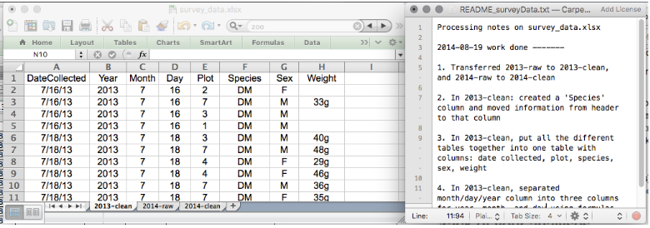
Keeping track of your analyses
When working with spreadsheets during data clean up or analyses you must:
…create a new file or tab with your cleaned or analyzed data. Do not modify the original dataset, or you will never know where you started!
…keep track of the steps you took in your clean up or analysis. You can do this in another text file, or a good option is to create a new tab in your spreadsheet with your notes.

Slide 41
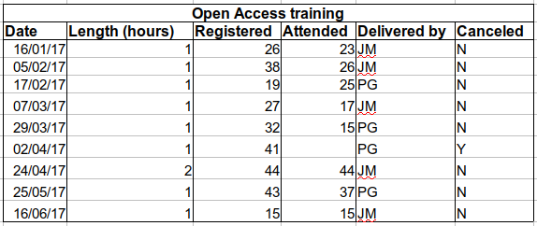
How to structure data tables
The cardinal rules of using spreadsheet programs for data:
Column = Variable
Row = Observation
Cell = Value
Tidy data tables
One cell–one value
One column–one variable
One row–one observation

Slide 42
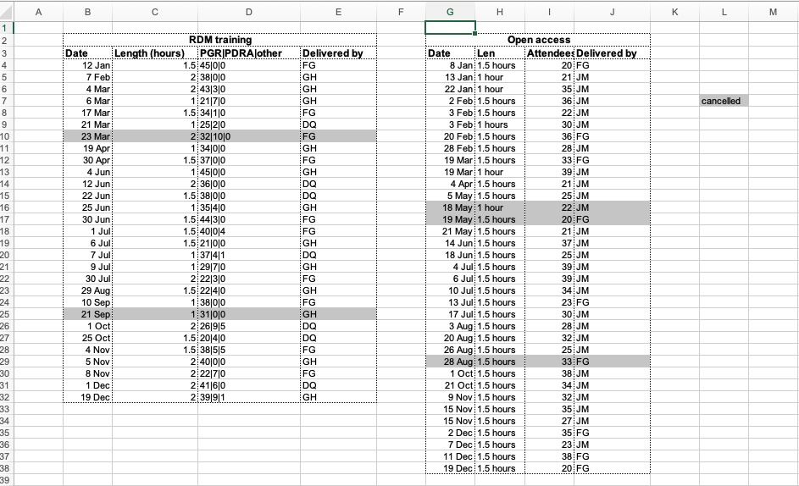
Tabular data
Do not:
 | create multiple data tables within one spreadsheet tab
 | combine values in cells
 | merging cells
 | use colors
 | write comments in cells
 | mix metadata and data
 | use special characters
 | use different date formats

Slide 43
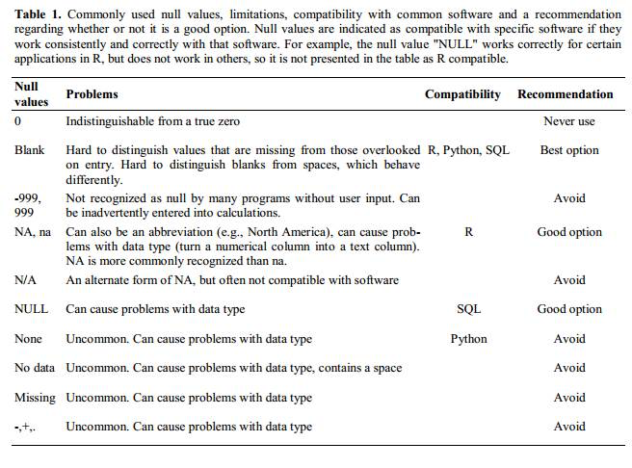
Missing data
Zero vs. Missing data - How do you make explicit something that do not exist?
White et al, 2013, Nine simple ways to make it easier to (re)use your data. Ideas in Ecology and Evolution

Slide 44
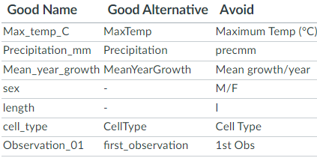
Field Name
For field names do not include spaces or special characters of any kind.
Underscores (_) are a good alternative to spaces
consider writing names in camelcase (LikeThis.txt) to improve readability.

Slide 45
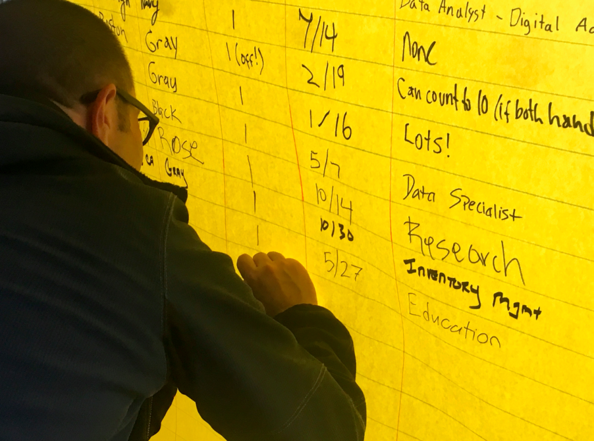
Exercise 9
We are going to take a messy version of some tabular data and begin cleaning it up using the information, tips and tricks.
Not important to finish the entire exercise
Work at your own speed, preferably in pairs or groups
Discuss the pros and cons of different ways to organise data in the spreadsheet
Consider the Human vs. Machine readability factors
This photo by Unknown author is licensed as CC BY-SA-NC

